Slide 1

CASE STUDY
(NLP)

Slide 2
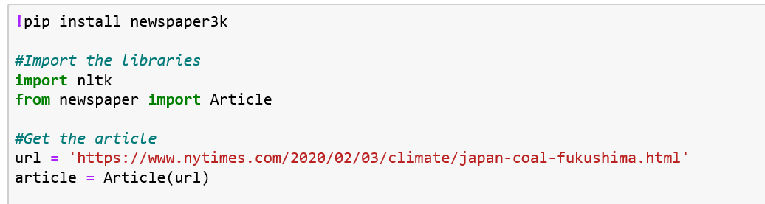
Article Summary

Slide 3
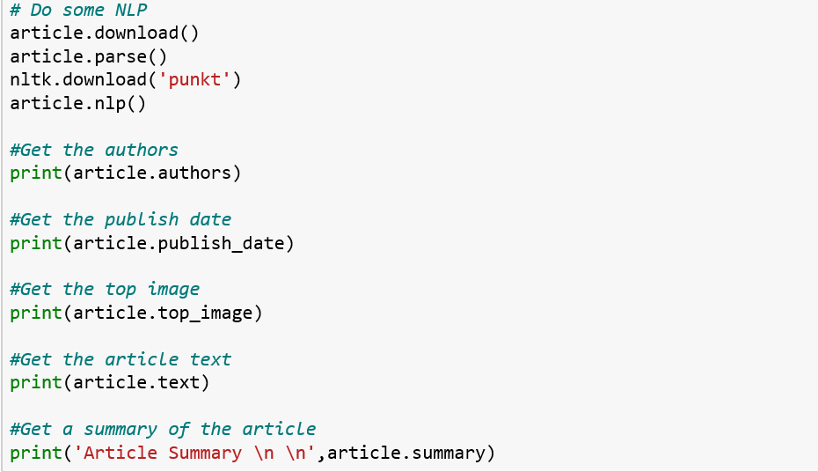
Article Summary

Slide 4
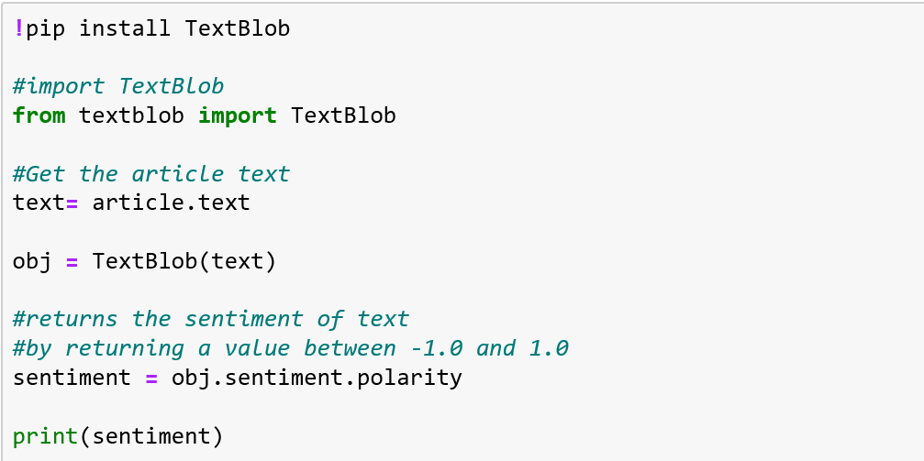
Sentiment of the Article

Slide 5
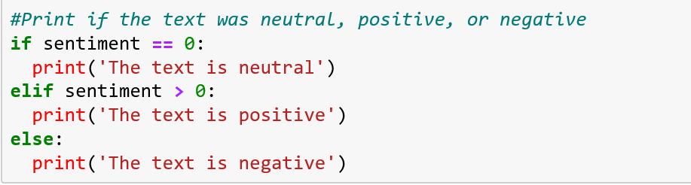
Sentiment of the Article

Slide 6
MOVIE Recommendation
The engine we will use is called a content based recommendation engine and it is a recommendation system that takes in a movie that a user likes and then analyzes it to get the movies content (e.g. genre, cast, director, keywords, etc.).
It then ranks the recommended movies based on how similar the recommended movies are to the liked movie using something called similarity scores

Slide 7
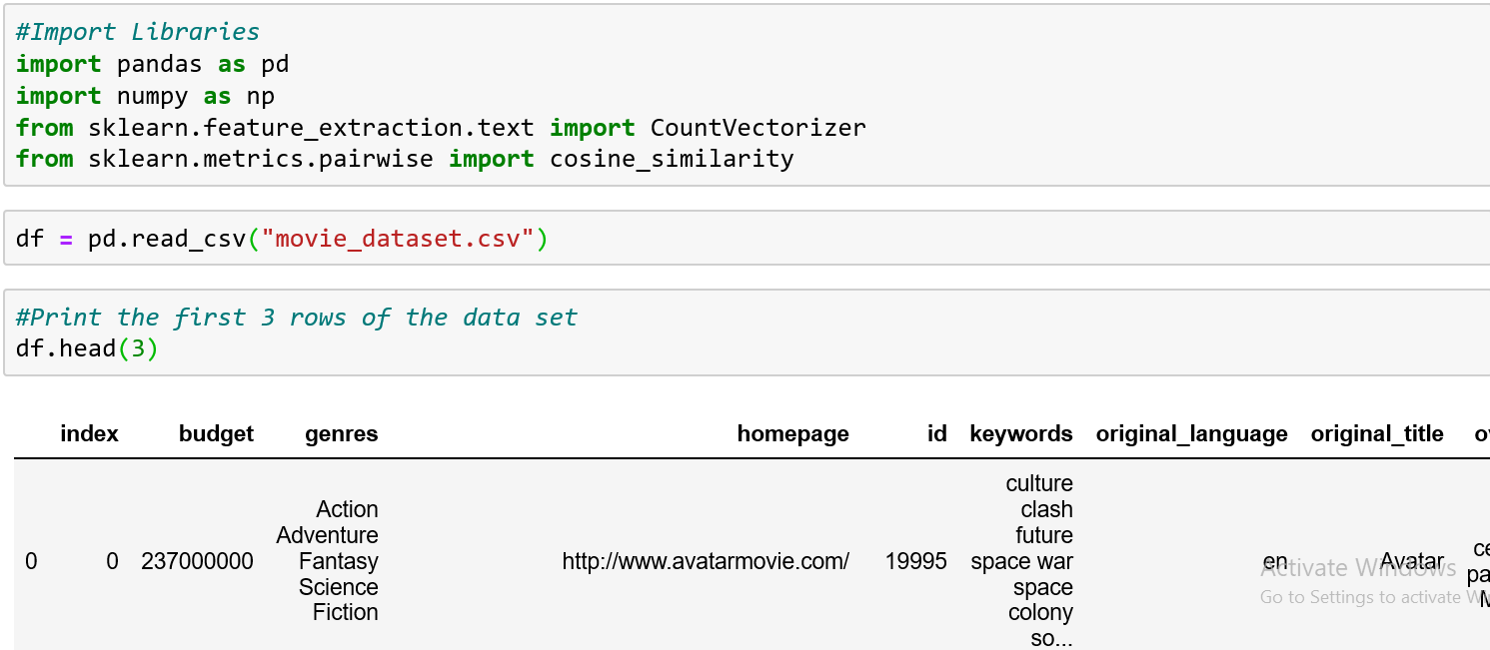
MOVIE Recommendation

Slide 8
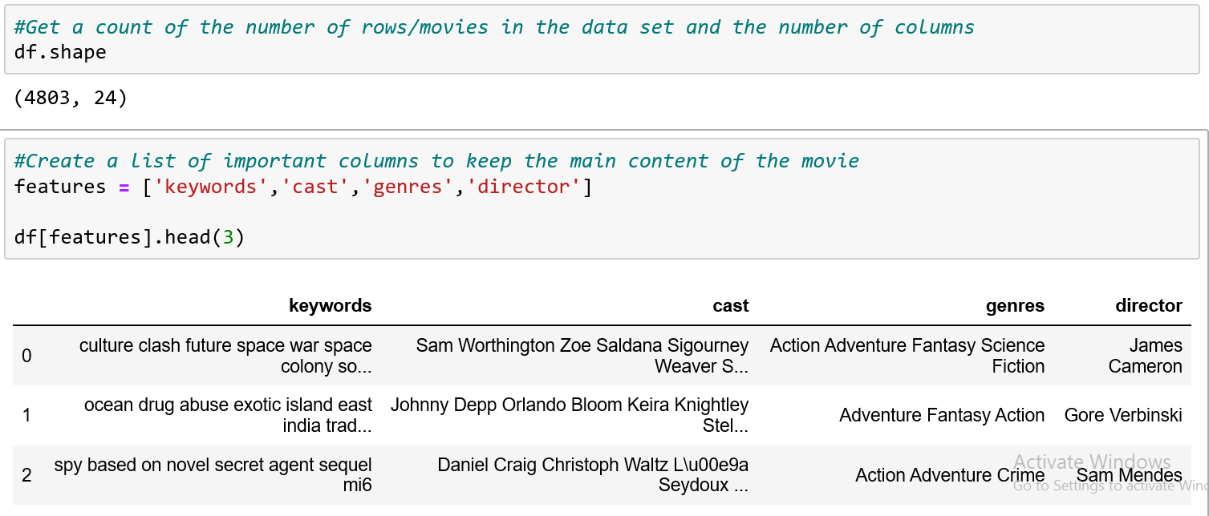
MOVIE Recommendation

Slide 9
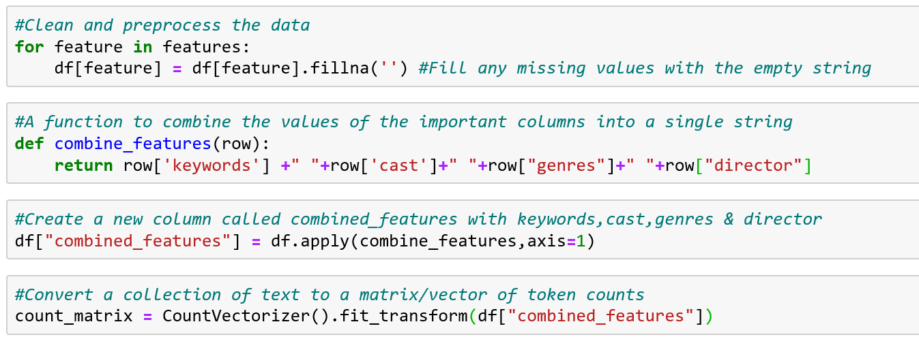
MOVIE Recommendation

Slide 10
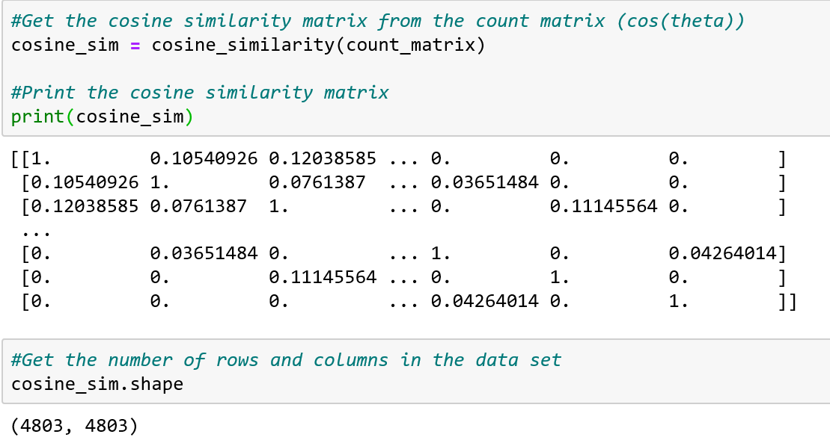
MOVIE Recommendation

Slide 11
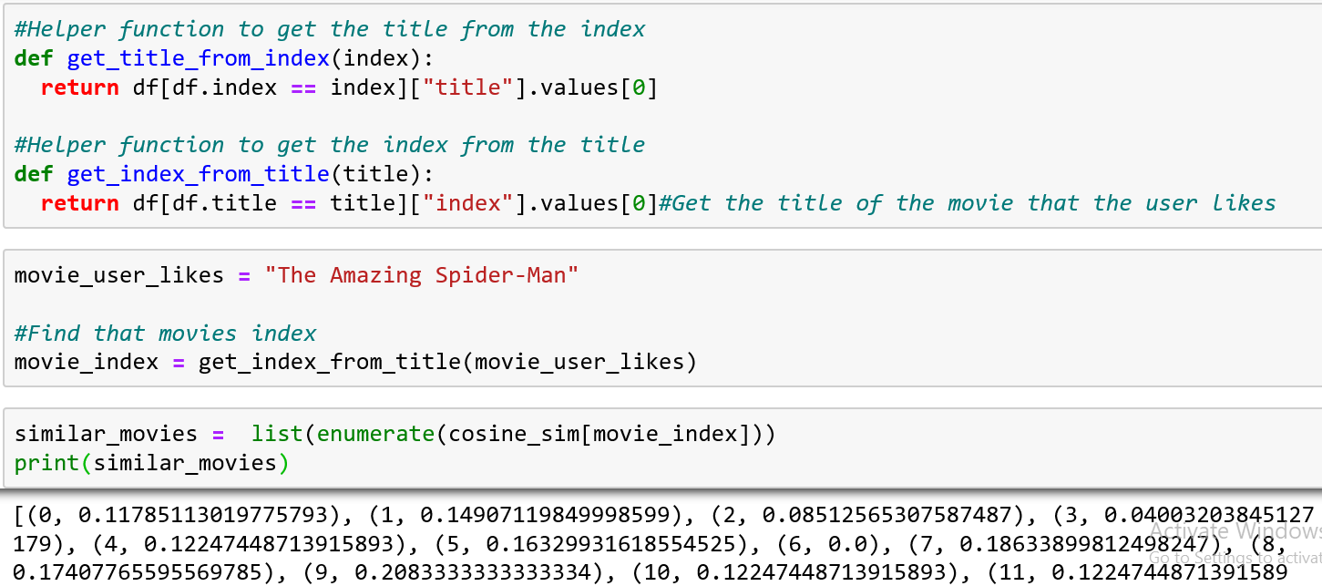
MOVIE Recommendation

Slide 12
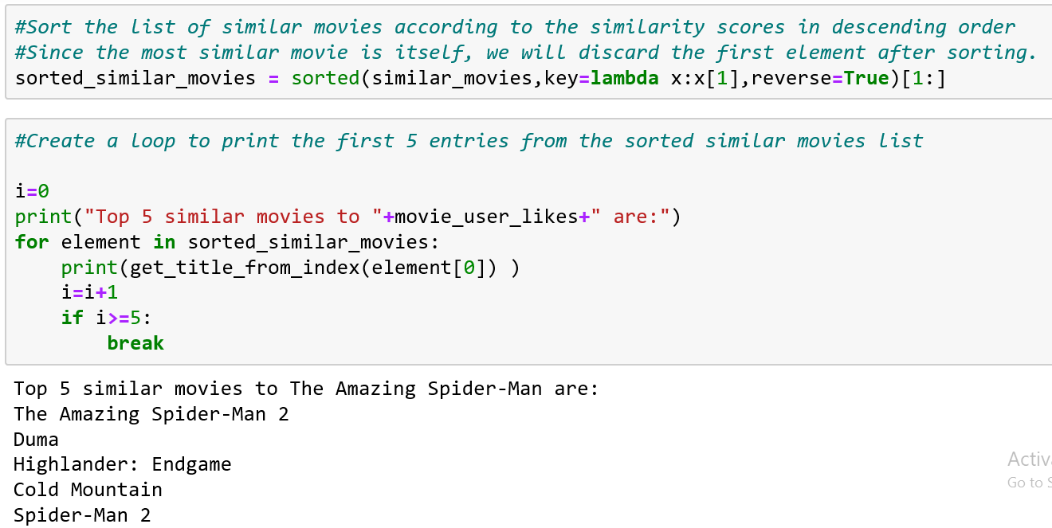
MOVIE Recommendation

Slide 13
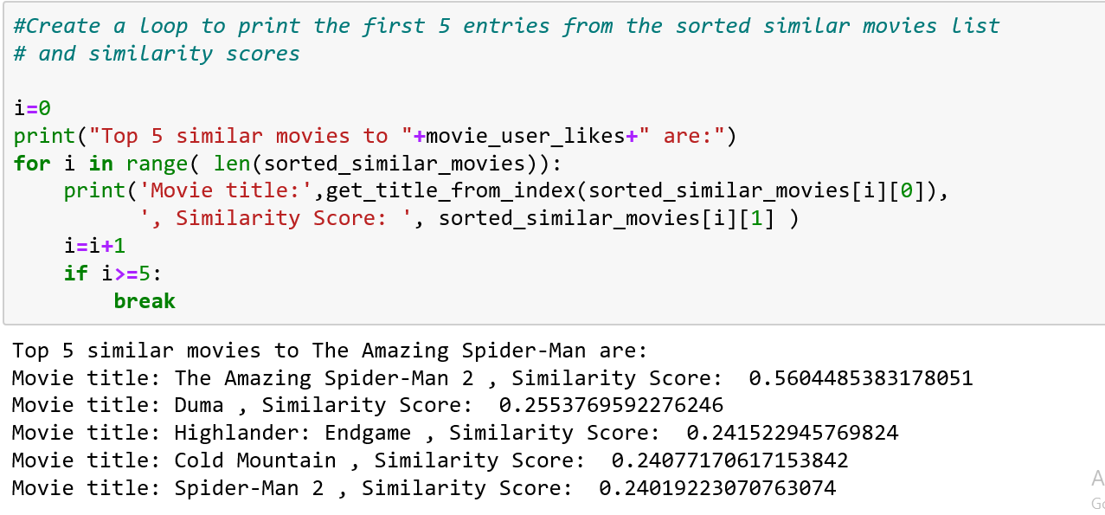
MOVIE Recommendation

Slide 14
THANK YOU

